Slide 1

Collateral
Presenter Name

Slide 2
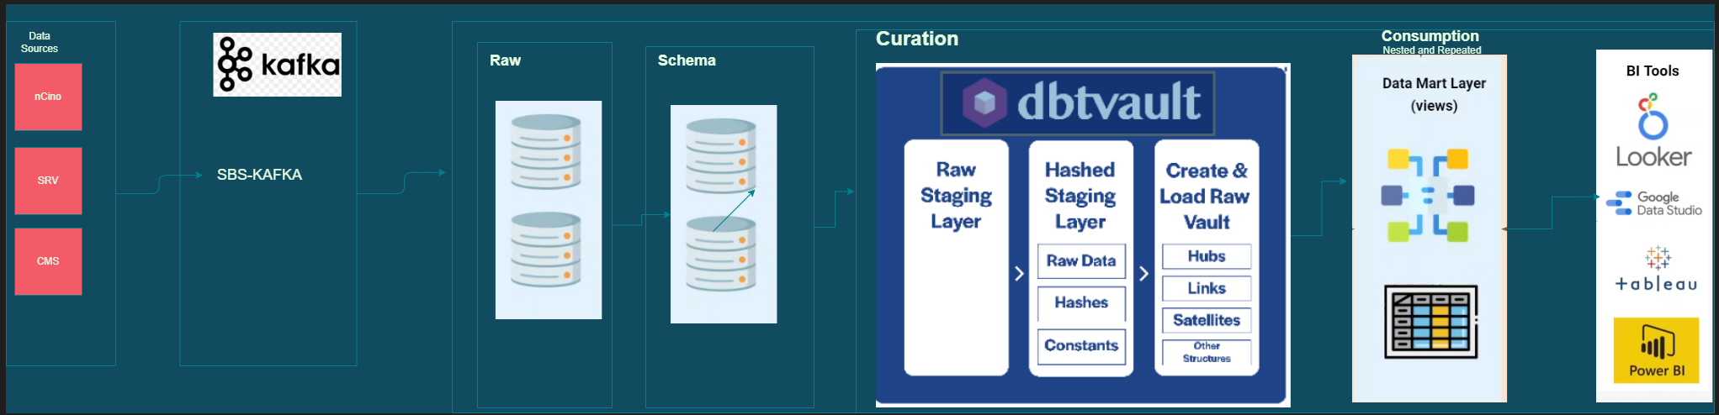

Slide 3
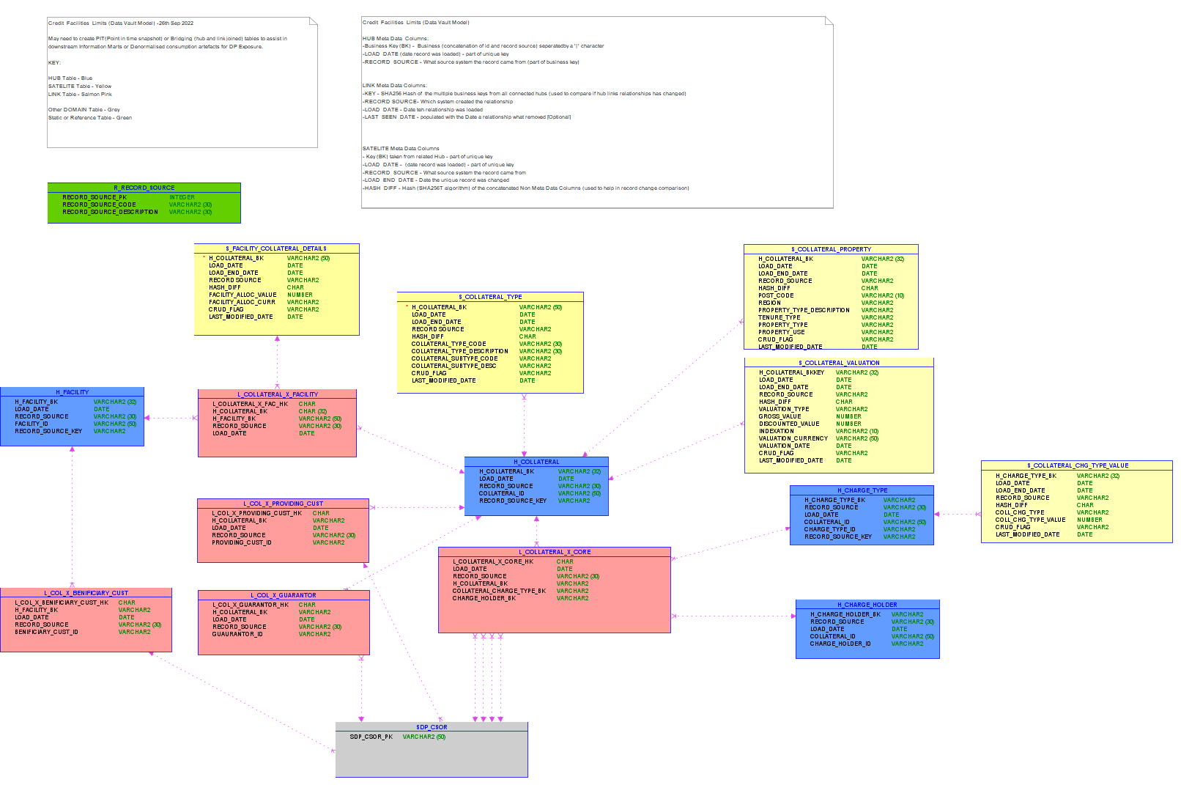
Collateral DATA VAULT Model

Slide 4
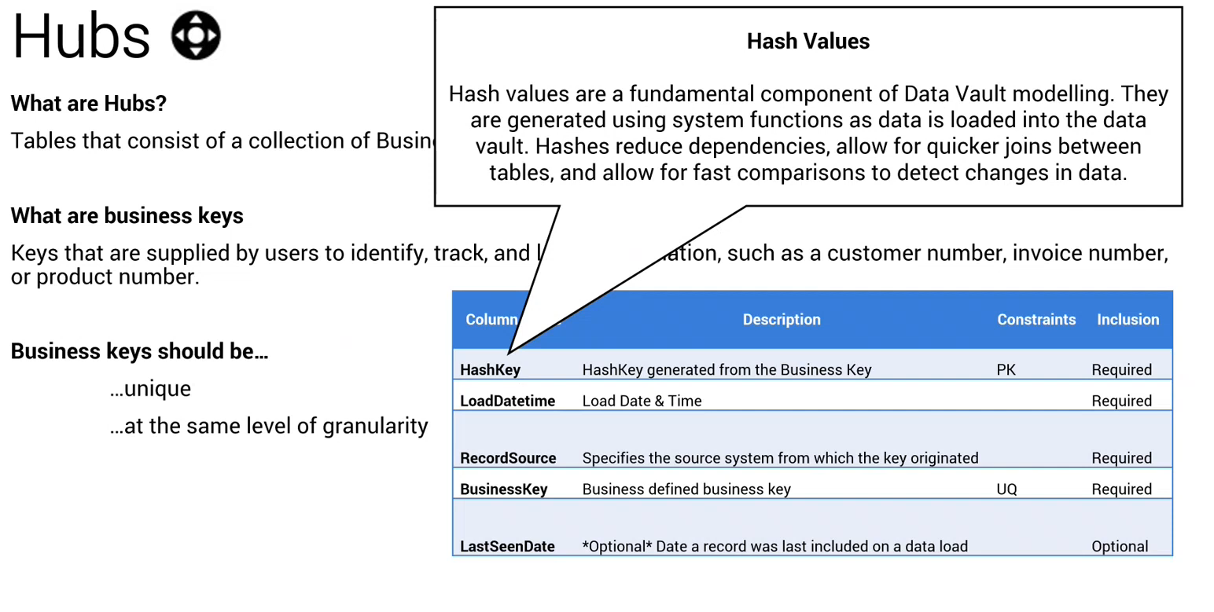

Slide 5
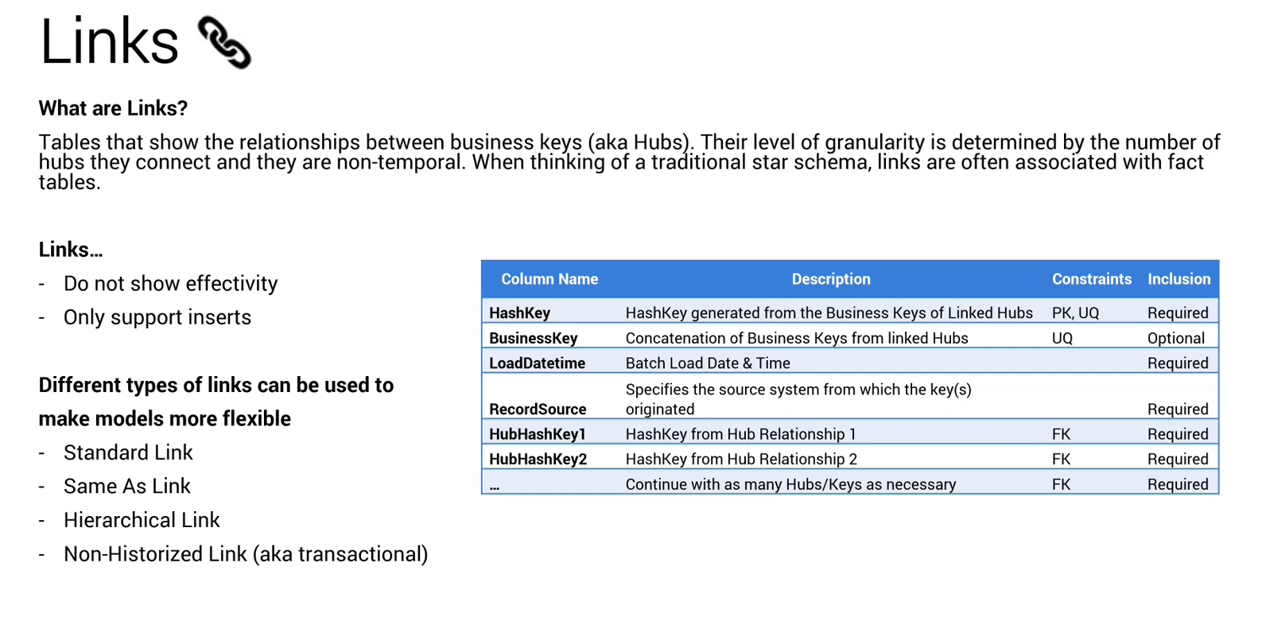

Slide 6
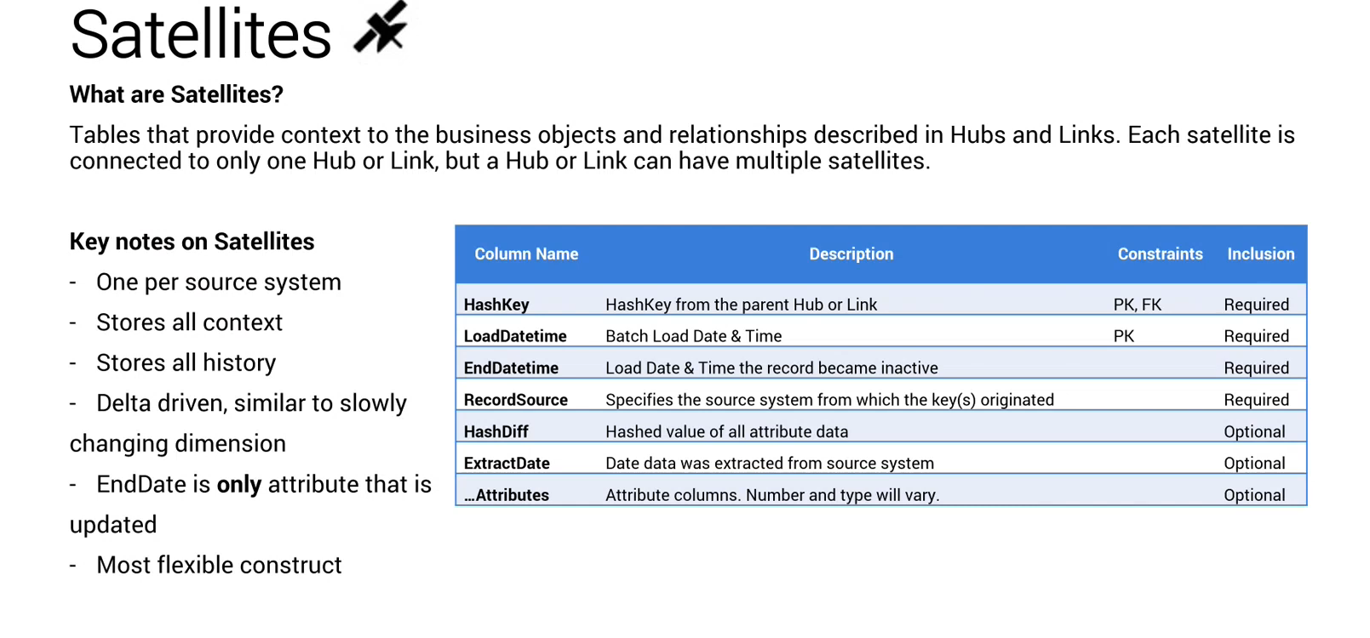

Slide 7
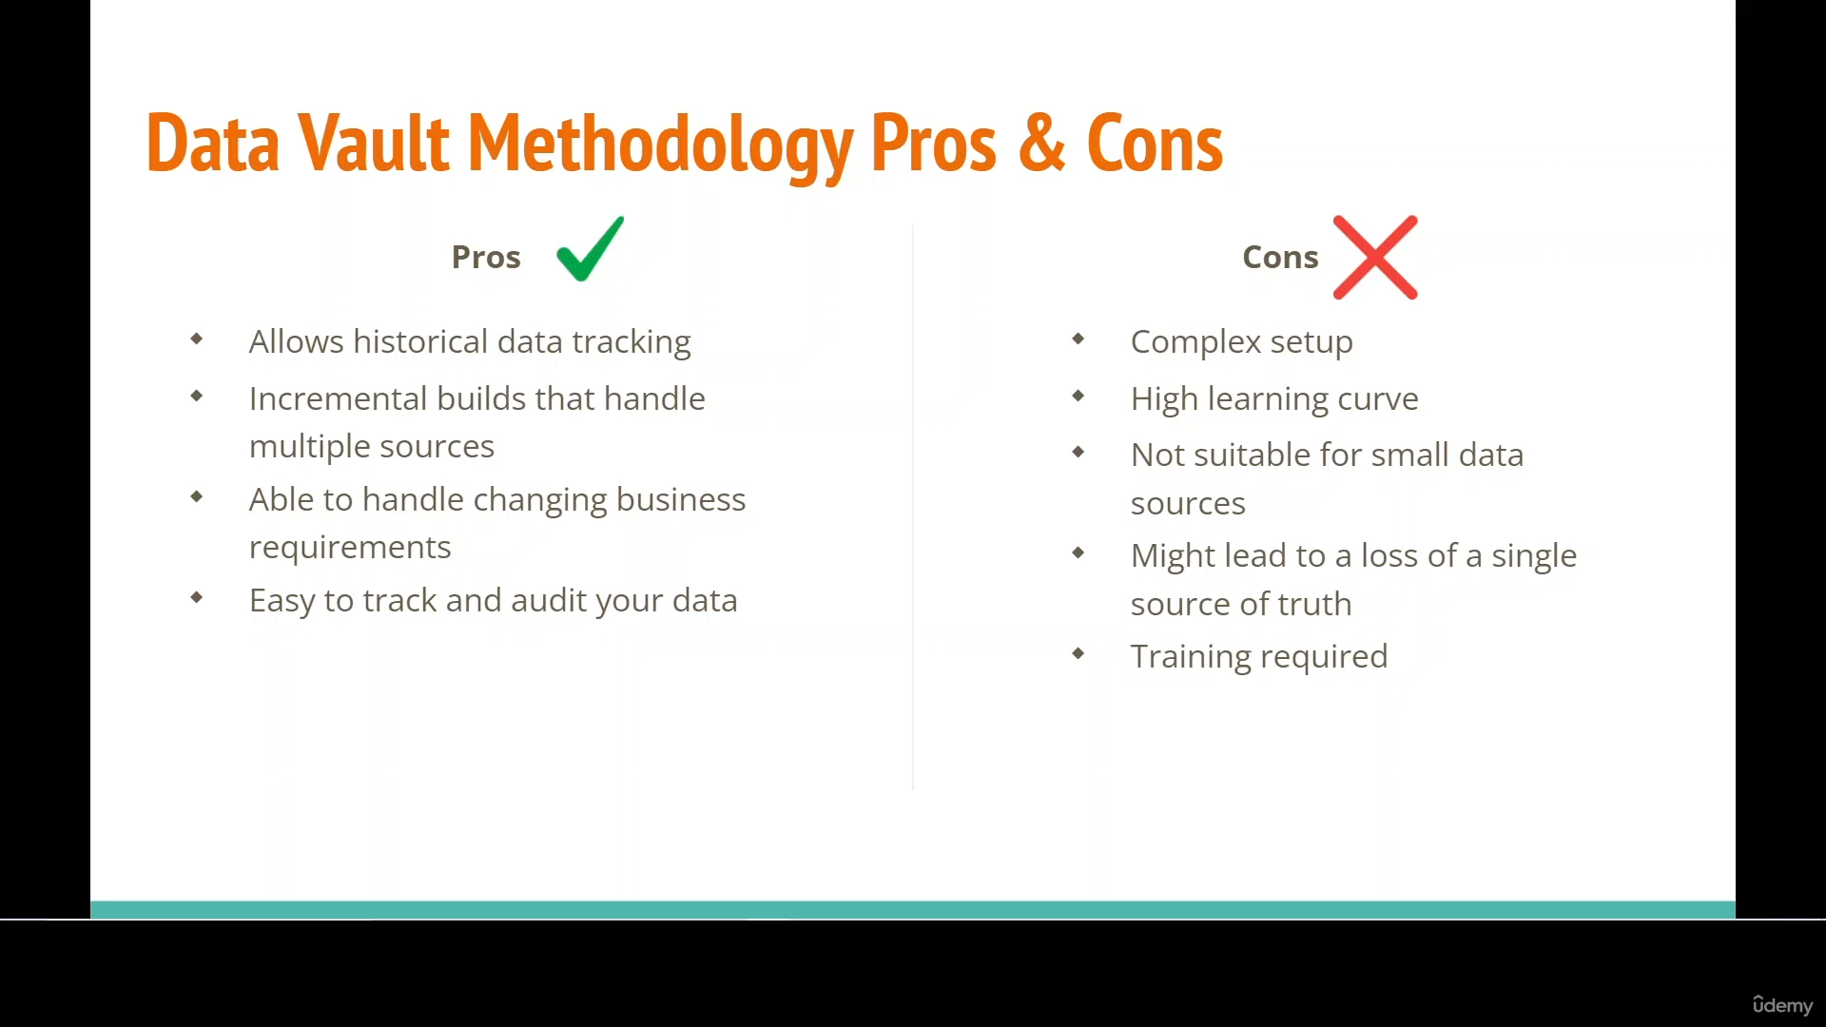

Slide 8
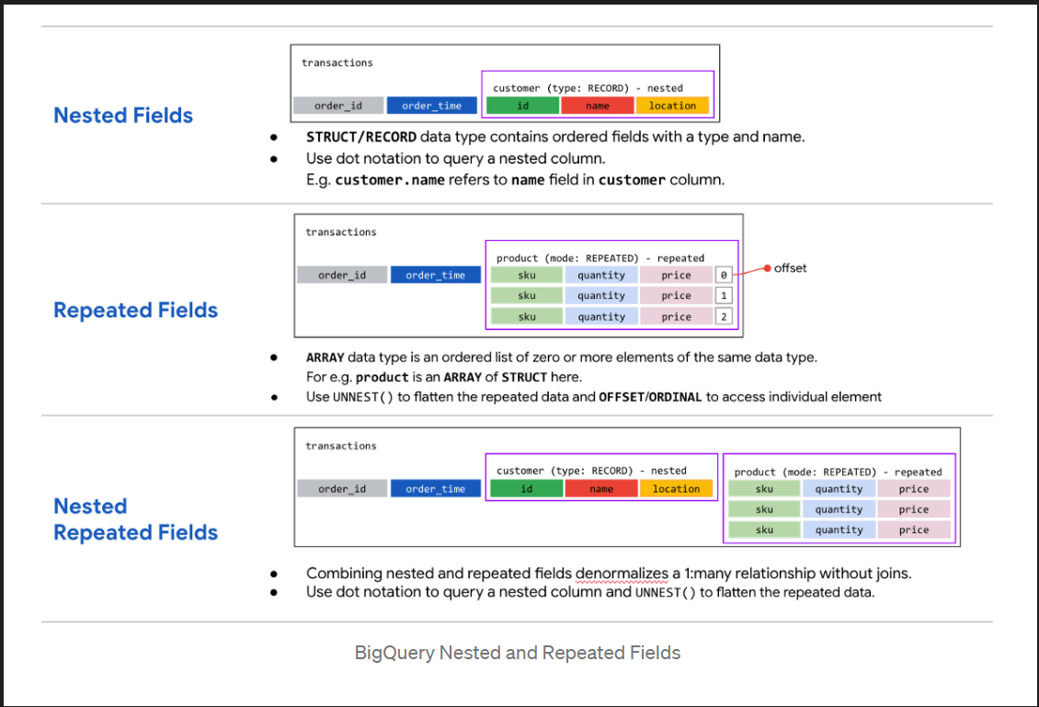

Slide 9
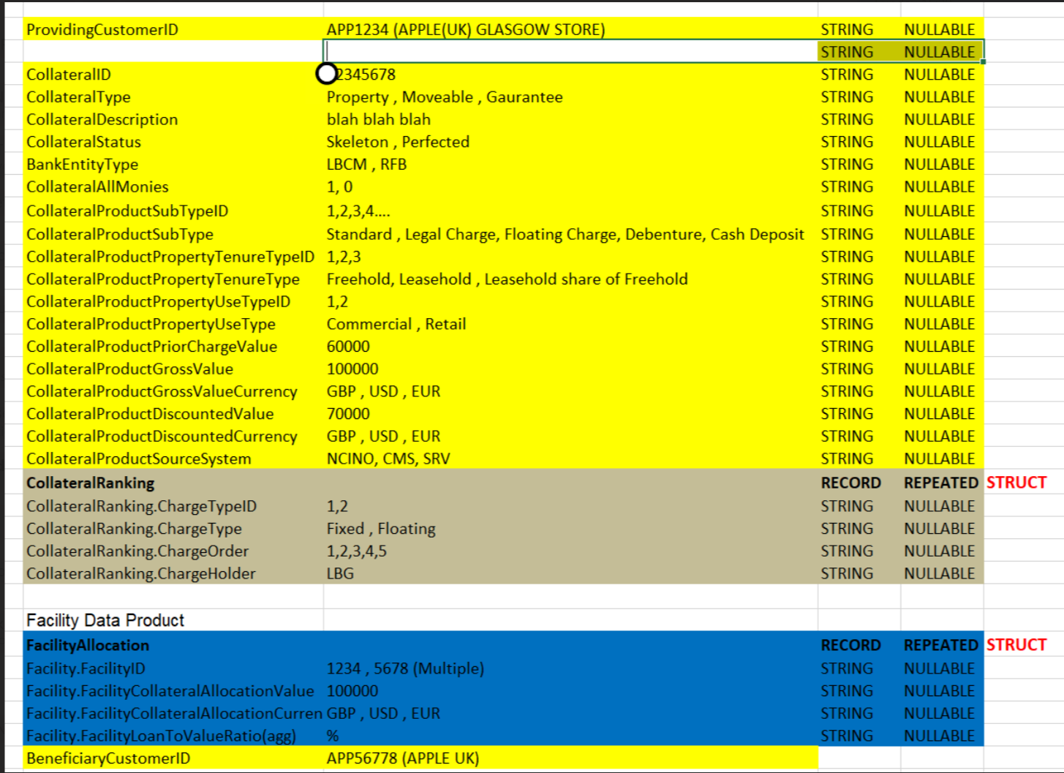
Collateral Nested and Repeated Model

Slide 10
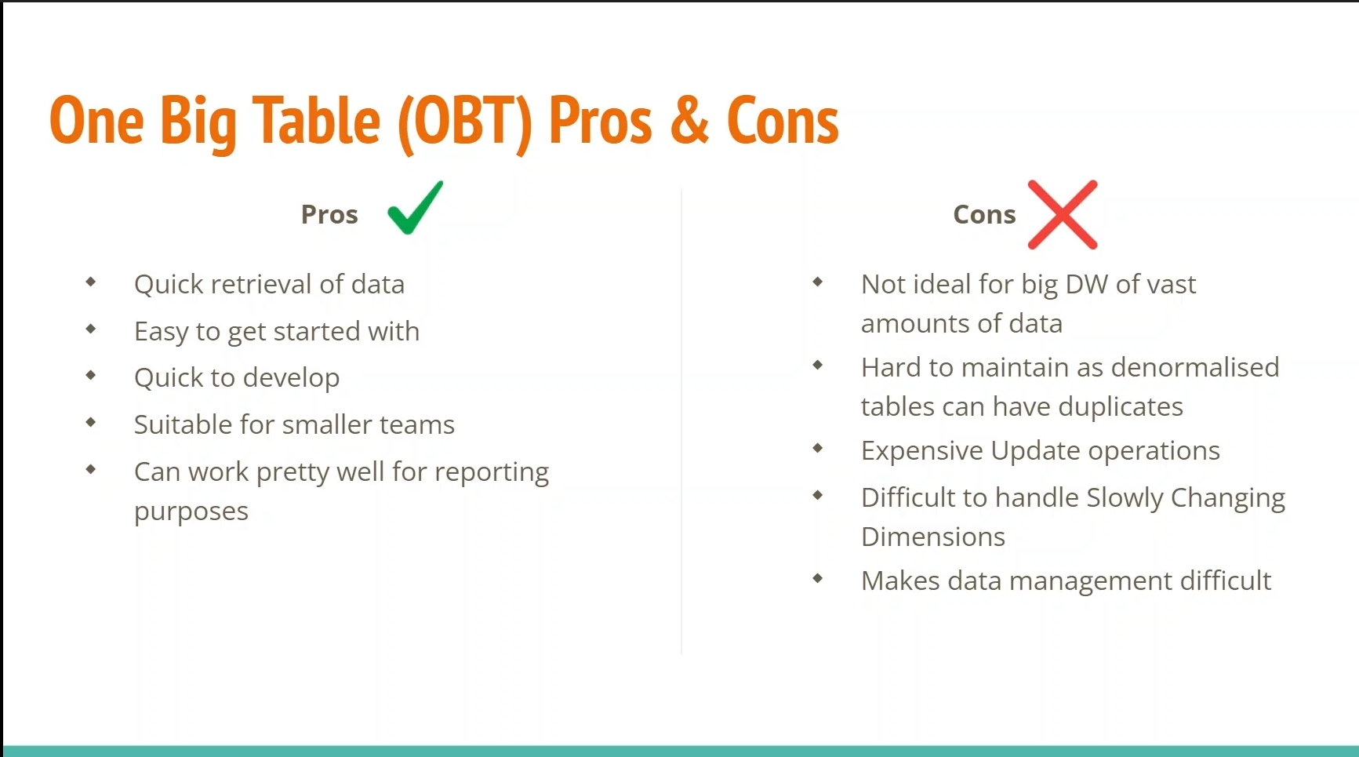

Slide 11
Chart

Slide 12
Table
 | Category 1 | Category 2 | Category 3 | Category 4
Item 1 | 4.5 | 2.3 | 1.7 | 5
Item 2 | 3.2 | 5.1 | 4.4 | 3
Item 3 | 2.1 | 1.7 | 2.5 | 2.8
Item 4 | 4.5 | 2.2 | 1.7 | 7

Slide 13


Thank You

